Slide 1
Sampling Based Inference
Il-Chul Moon
Dept. of Industrial and Systems Engineering
KAIST
icmoon@kaist.ac.kr

Slide 2
Weekly Objectives
Learn basic sampling methods
  Understand the concept of Markov chain Monte Carlo
  Able to apply MCMC to the parameter inference of Bayesian networks
  Know the mechanism of rejection sampling
  Know the mechanism of importance sampling
Learn sampling based inference
  Understand the concept of Metropolis-Hastings Algorithm
  Know the mechanism of Gibbs sampling
Know a case study of sampling based inference
  Understand the latent Dirichlet allocation model
  Know the collapsed Gibbs sampling
  Know how to derive Gibbs sampling formula for LDA

Slide 3
Sampling based inference

Slide 4
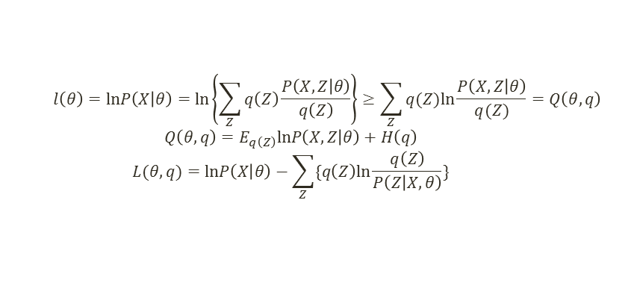
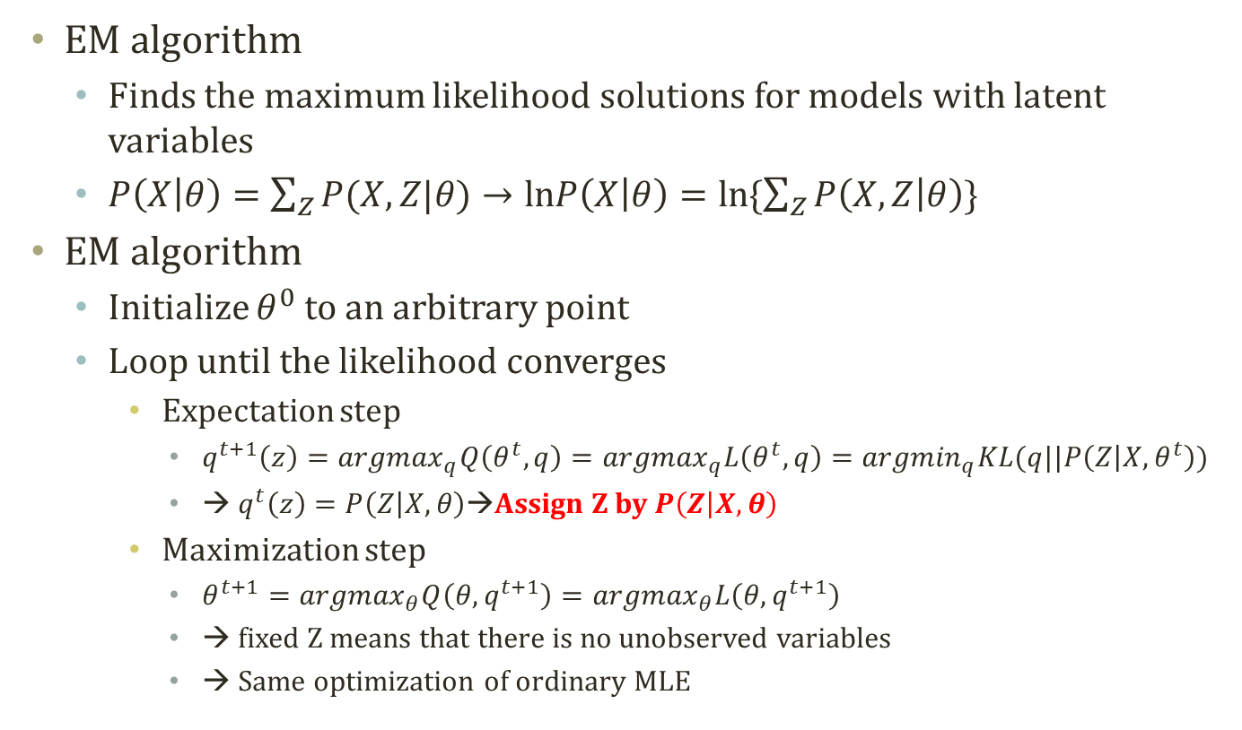
Detour:
EM Algorithm
  $$l\left(θ\right)=lnP\left(X | θ\right)=ln\left\{\sum_{Z}{q\left(Z\right)\frac{P\left(X,Z | θ\right)}{q\left(Z\right)}}\right\}≥\sum_{Z}{q(Z)ln\frac{P\left(X,Z | θ\right)}{q(Z)}}=Q\left(θ,q\right)$$
  $$Q\left(θ,q\right)=E_{q\left(Z\right)}lnP\left(X,Z | θ\right)+H\left(q\right)$$
  $$L(θ,q)=lnP\left(X | θ\right)−\sum_{Z}{\{q\left(Z\right)ln\frac{q\left(Z\right)}{P\left(Z | X,θ\right)}\}}$$
EM algorithm
  Finds the maximum likelihood solutions for models with latent variables
  $P\left(X | θ\right)=\sum_{Z}{P(X,Z|θ)}→lnP\left(X | θ\right)=ln\{\sum_{Z}{P\left(X,Z | θ\right)}\}$
EM algorithm
  Initialize $θ^{0}$ to an arbitrary point
  Loop until the likelihood converges
    Expectation step
      $q^{t+1}\left(z\right)={argmax}_{q}Q\left(θ^{t},q\right)={argmax}_{q}L\left(θ^{t},q\right)={argmin}_{q}KL(q||P\left(Z | X,θ^{t}\right))$
      → $q^{t}\left(z\right)=P\left(Z | X,θ\right)$→Assign Z by $P\left(Z | X,θ\right)$
    Maximization step
      $θ^{t+1}={argmax}_{θ}Q\left(θ,q^{t+1}\right)={argmax}_{θ}L\left(θ,q^{t+1}\right)$
      → fixed Z means that there is no unobserved variables
      → Same optimization of ordinary MLE
Computing Expectation….
Sometimes, it can be hard

Slide 5


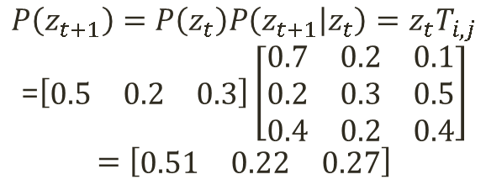
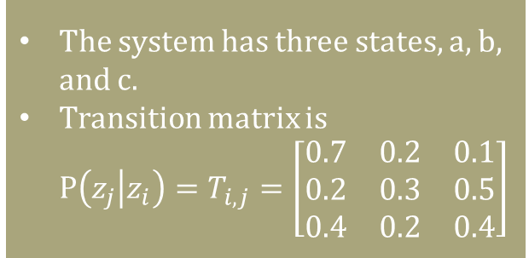

Markov Chain
Markov chain
  Each node has a probability distribution of states
    i.e.) The probability that a state is the current state of a system
      Concrete observation of a system: [1 0 0] → the system is at the first state
      Stochastic observation of a system: [0.7 0.2 0.1] → the system is likely at the first state
    The node has a vector of state probability distribution
  Each link suggests a probabilistic state transition
    If a system is at the first state, the probability distribution of the next state is [0.3 0.4 0.3]
    The link has a matrix of state transition probability distribution.
$$z_{t}=\left[\begin{matrix}0.5 & 0.2 & 0.3\end{matrix}\right]$$
$$z_{t}$$
$$z_{t+1}$$
The system has three states, a, b, and c.
Transition matrix is
$P\left(z_{j} | z_{i}\right)=T_{i,j}=\left[\begin{matrix}\begin{matrix}0.7 \\ 0.2 \\ 0.4\end{matrix} & \begin{matrix}0.2 \\ 0.3 \\ 0.2\end{matrix} & \begin{matrix}0.1 \\ 0.5 \\ 0.4\end{matrix}\end{matrix}\right]$
$$P\left(z_{t+1}\right)=P\left(z_{t}\right)P\left(z_{t+1} | z_{t}\right)=z_{t}T_{i,j}$$
=$\left[\begin{matrix}0.5 & 0.2 & 0.3\end{matrix}\right]\left[\begin{matrix}\begin{matrix}0.7 \\ 0.2 \\ 0.4\end{matrix} & \begin{matrix}0.2 \\ 0.3 \\ 0.2\end{matrix} & \begin{matrix}0.1 \\ 0.5 \\ 0.4\end{matrix}\end{matrix}\right]$
$$=\left[\begin{matrix}0.51 & 0.22 & 0.27\end{matrix}\right]$$

Slide 6
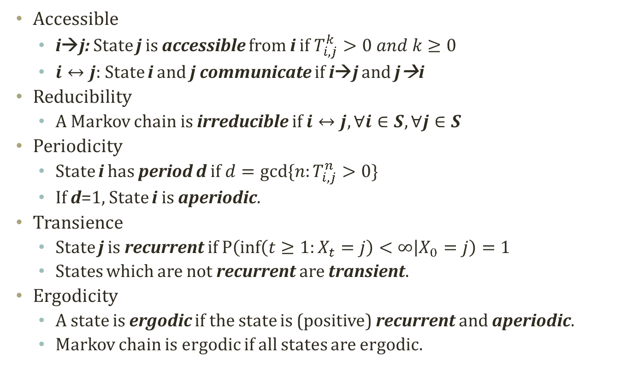
Properties of Markov Chain
Accessible
  i→j: State j is accessible from i if $T_{i,j}^{k}>0 and k≥0$
  $i↔j$: State i and j communicate if i→j and j→i
Reducibility
  A Markov chain is irreducible if $i↔j, ∀i∈S,∀j∈S$
Periodicity
  State i has period d if $d=gcd⁡\{n:T_{i,j}^{n}>0\}$
  If d=1, State i is aperiodic.
Transience
  State j is recurrent if $P\left(\inf\left(t≥1:X_{t}=j\right)<∞ | X_{0}=j\right)=1$
  States which are not recurrent are transient.
Ergodicity
  A state is ergodic if the state is (positive) recurrent and aperiodic.
  Markov chain is ergodic if all states are ergodic.

Slide 7
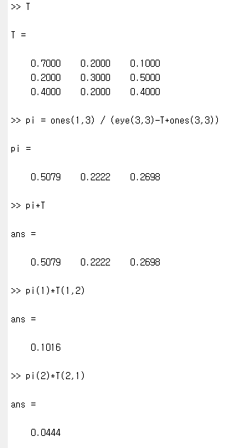
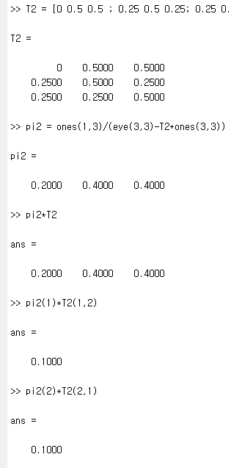

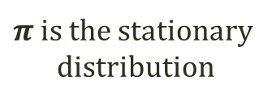
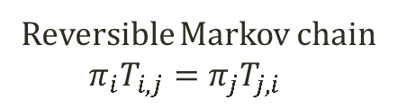
Stationary
Distribution
${RT}_{i}=min⁡\{n>0:X_{n}=i|X_{0}=i\}$
  Return time to state i after the
  departure from state i
Limit theorem of Markov chain
  A friend in ISE dept. told me…..
  If a Markov chain is irreducible and
  ergodic
    $π_{i}=\lim_{n→∞}{T_{i,j}^{(n)}}=\frac{1}{E[{RT}_{i}]}$
    $π_{i}$ is uniquely determined by the set
    of equations
      $π_{i}≥0,\sum_{i∈S}{π_{i}}=1,π_{j}=\sum_{i∈S}{π_{i}T_{i,j}}$
  How to compute $π$ given $T$
    $π\left(I_{\left|S\right|,\left|S\right|}−T+1_{\left|S\right|,\left|S\right|}\right)=1_{1,|S|}$
      $π_{j}=\sum_{i∈S}{π_{i}T_{i,j}}→π_{j}−\sum_{i∈S}{π_{i}T_{i,j}}=0→π\left(I_{\left|S\right|,\left|S\right|}−T\right)=0$
        To the above formula, apply $\sum_{i∈S}{π_{i}}=1→π1_{\left|S\right|,\left|S\right|}=1_{1,|S|}$ to both sides
      $π\left(I_{\left|S\right|,\left|S\right|}−T+1_{\left|S\right|,\left|S\right|}\right)=1_{1,|S|}$
  Here, $π$ is the stationary distribution!
Irreversible MC
Reversible MC
$π$ is the stationary
distribution
Reversible Markov chain
  $$π_{i}T_{i,j}=π_{j}T_{j,i}$$
Detailed Balance, or Balance Equation

Slide 8

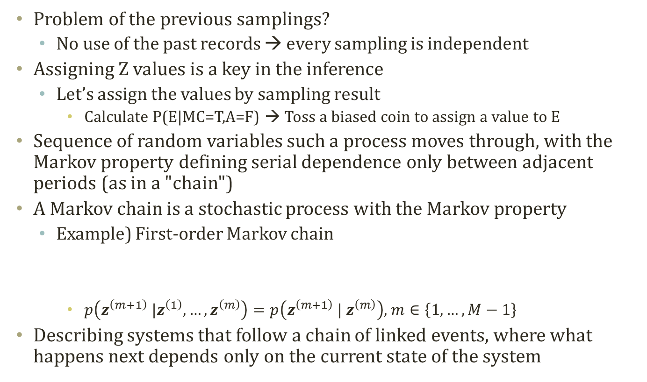



Markov Chain for Sampling
Problem of the previous samplings?
  No use of the past records → every sampling is independent
Assigning Z values is a key in the inference
  Let’s assign the values by sampling result
    Calculate P(E|MC=T,A=F) → Toss a biased coin to assign a value to E
Sequence of random variables such a process moves through, with the Markov property defining serial dependence only between adjacent periods (as in a "chain")
A Markov chain is a stochastic process with the Markov property
  Example) First-order Markov chain
    $p\left(z^{\left(m+1\right)} |z^{\left(1\right)},…,z^{\left(m\right)}\right)=p\left(z^{\left(m+1\right)} | z^{\left(m\right)}\right)$, $m∈\left\{1,…,M−1\right\}$
Describing systems that follow a chain of linked events, where what happens next depends only on the current state of the system
$$z_{1}$$
$$z_{2}$$
$$z_{3}$$
$$z_{4}$$

Slide 9
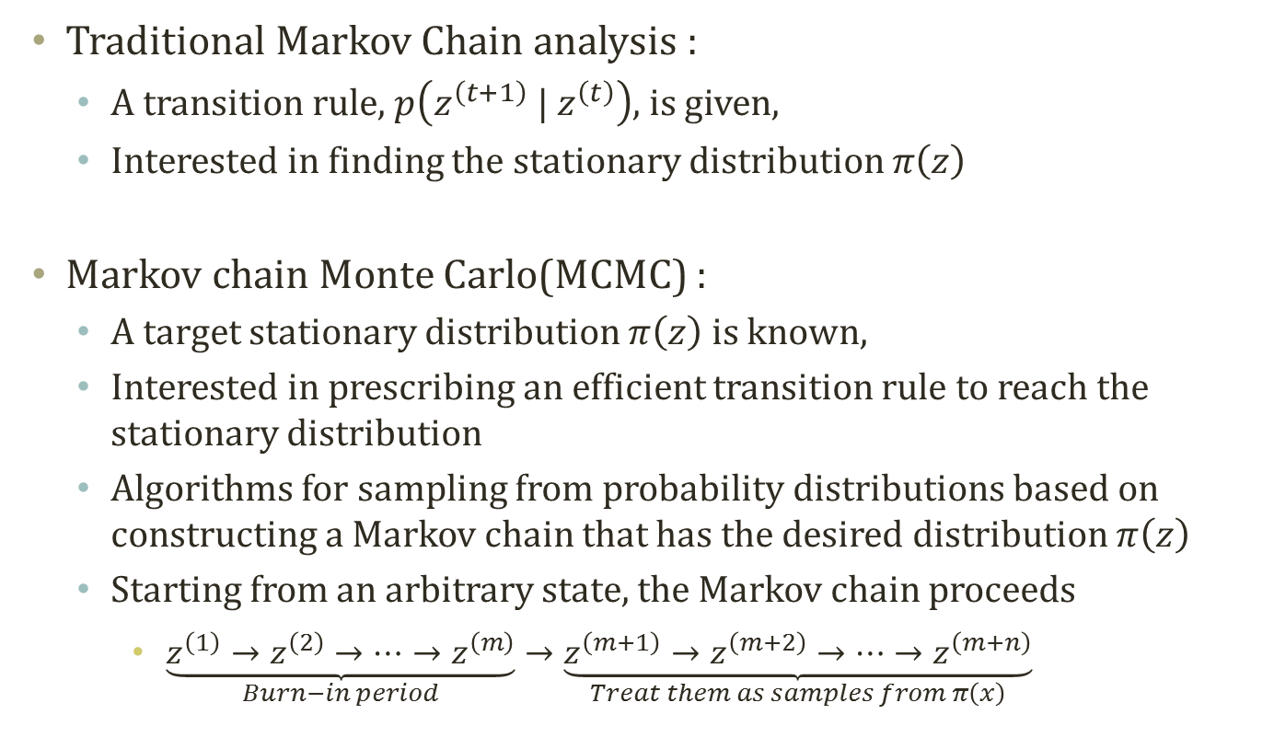




Markov chain theory vs.
Markov Chain Monte Carlo
Traditional Markov Chain analysis :
  A transition rule, $p\left(z^{\left(t+1\right)} | z^{\left(t\right)}\right)$, is given,
  Interested in finding the stationary distribution $π\left(z\right)$
Markov chain Monte Carlo(MCMC) :
  A target stationary distribution $π\left(z\right)$ is known,
  Interested in prescribing an efficient transition rule to reach the stationary distribution
  Algorithms for sampling from probability distributions based on constructing a Markov chain that has the desired distribution $π\left(z\right)$
  Starting from an arbitrary state, the Markov chain proceeds
    $\underset{Burn−in period}{\underbrace{z^{\left(1\right)}→z^{\left(2\right)}→⋯→z^{\left(m\right)}}}→\underset{Treat them as samples from π\left(x\right)}{\underbrace{z^{\left(m+1\right)}→z^{\left(m+2\right)}→⋯→z^{\left(m+n\right)}}}$
$$z_{1}$$
$$z_{2}$$
$$z_{3}$$
$$z_{4}$$
slides adopted from Prof. Park Tae Young’s
Notes:
Since convergence usually occurs regardless of our starting point, we can usually pick any feasible (for example, picking starting draws that are in the parameter space) starting point. However, the time it takes for the chain to converge varies depending on the starting point.
As a matter of practice, most people throw out a certain number of the ﬁrst draws, known as the burn-in. This is to make our draws closer to the stationary distribution and less dependent on the starting point. However, it is unclear how much we should burn-in since our draws are all slightly dependent and we don’t know exactly when convergence occurs.

Slide 10
Markov Chain of Z
Buglary
Earthquake
Buglary
Earthquake
Alarm
Alarm
JohnCalls
MaryCalls
JohnCalls
MaryCalls
Buglary
Earthquake
Buglary
Earthquake
Alarm
Alarm
JohnCalls
MaryCalls
JohnCalls
MaryCalls

Slide 11
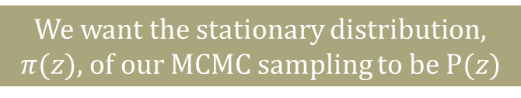
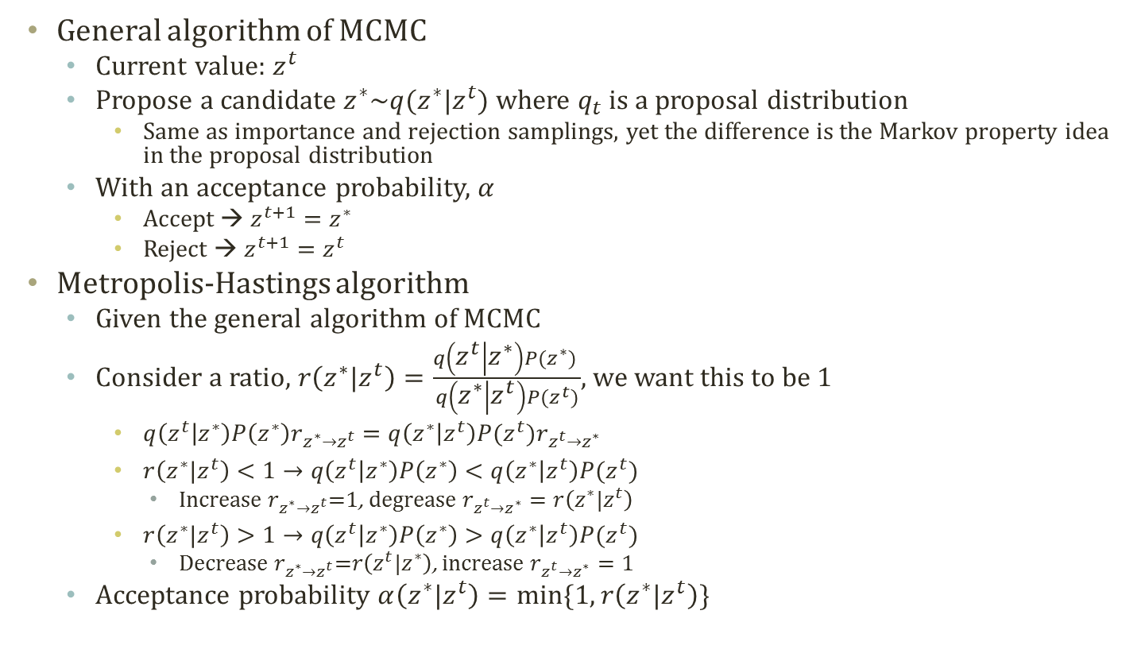

Metropolis-Hastings Algorithm
    $q\left(z^{t} | z^{∗}\right)P\left(z^{∗}\right)<q\left(z^{∗} | z^{t}\right)P(z^{t})$→Movement from $z^{t}$ to $z^{∗}$ is too often
We want the stationary distribution, $π(z)$, of our MCMC sampling to be $P(z)$
General algorithm of MCMC
  Current value: $z^{t}$
  Propose a candidate $z^{∗}\sim q(z^{∗}|z^{t})$ where $q_{t}$ is a proposal distribution
    Same as importance and rejection samplings, yet the difference is the Markov property idea in the proposal distribution
  With an acceptance probability, $α$
    Accept → $z^{t+1}=z^{∗}$
    Reject → $z^{t+1}=z^{t}$
Metropolis-Hastings algorithm
  Given the general algorithm of MCMC
  Consider a ratio, $r\left(z^{∗}|z^{t}\right)=\frac{q\left(z^{t} | z^{∗}\right)P(z^{∗}) }{q\left(z^{∗} | z^{t}\right)P(z^{t})}$, we want this to be 1
    $q\left(z^{t} | z^{∗}\right)P\left(z^{∗}\right)r_{z^{∗}→z^{t}}=q\left(z^{∗} | z^{t}\right)P(z^{t})r_{z^{t}→z^{∗}}$
    $r\left(z^{∗}|z^{t}\right)<1→q\left(z^{t} | z^{∗}\right)P\left(z^{∗}\right)<q\left(z^{∗} | z^{t}\right)P(z^{t})$
      Increase $r_{z^{∗}→z^{t}}$=1, degrease $r_{z^{t}→z^{∗}}=r\left(z^{∗}|z^{t}\right)$
    $r\left(z^{∗}|z^{t}\right)>1→q\left(z^{t} | z^{∗}\right)P\left(z^{∗}\right)>q\left(z^{∗} | z^{t}\right)P(z^{t})$
      Decrease $r_{z^{∗}→z^{t}}$=$r\left(z^{t}|z^{∗}\right)$, increase $r_{z^{t}→z^{∗}}=1$
  Acceptance probability $α\left(z^{∗}|z^{t}\right)=min⁡\{1,r\left(z^{∗}|z^{t}\right)\}$
Reversible Markov chain
$$π_{i}T_{i,j}=π_{j}T_{j,i}$$
q is not well-designed to be the reversible MC, so we adjust by r

Slide 12

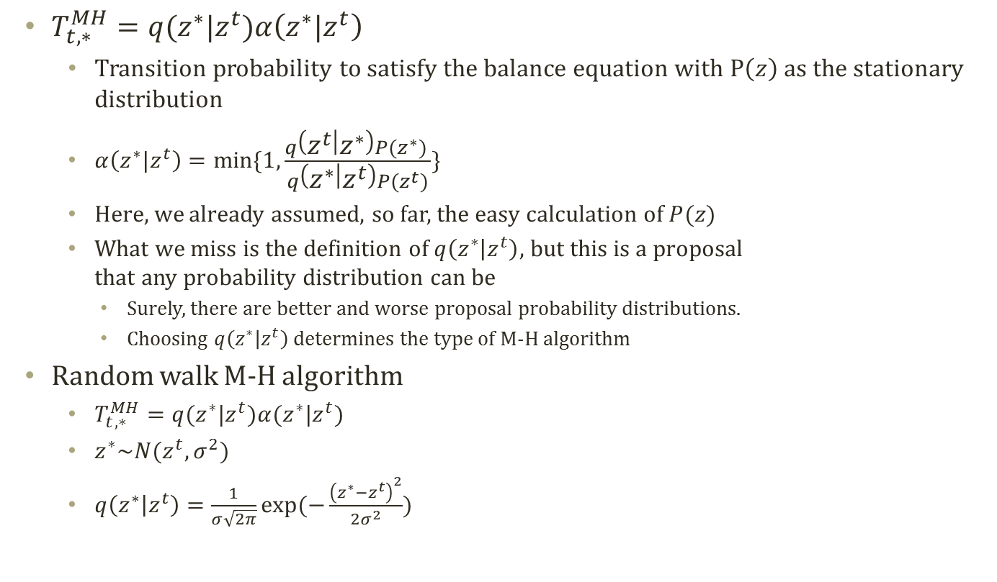



Random Walk M-H Algorithm
  $T_{t,∗}^{MH}=q(z^{∗}|z^{t})α\left(z^{∗}|z^{t}\right)$
    Transition probability to satisfy the balance equation with $P\left(z\right)$ as the stationary distribution
    $α\left(z^{∗}|z^{t}\right)=min⁡\{1,\frac{q\left(z^{t} | z^{∗}\right)P(z^{∗}) }{q\left(z^{∗} | z^{t}\right)P(z^{t})}\}$
    Here, we already assumed, so far, the easy calculation of $P(z)$
    What we miss is the definition of $q\left(z^{∗} | z^{t}\right)$, but this is a proposal
    that any probability distribution can be
      Surely, there are better and worse proposal probability distributions.
      Choosing $q\left(z^{∗} | z^{t}\right)$ determines the type of M-H algorithm
  Random walk M-H algorithm
    $T_{t,∗}^{MH}=q(z^{∗}|z^{t})α(z^{∗}|z^{t})$
    $z^{∗}\sim N(z^{t},σ^{2})$
    $q\left(z^{∗} | z^{t}\right)=\frac{1}{σ\sqrt{2π}}exp⁡(−\frac{{\left(z^{∗}−z^{t}\right)}^{2}}{2σ^{2}})$
Sample t
Accept
$$z^{t}$$
$$z^{∗}$$
Sample t+1
$$z^{∗}$$
$$z^{t}$$
Random Walk Process

Slide 13
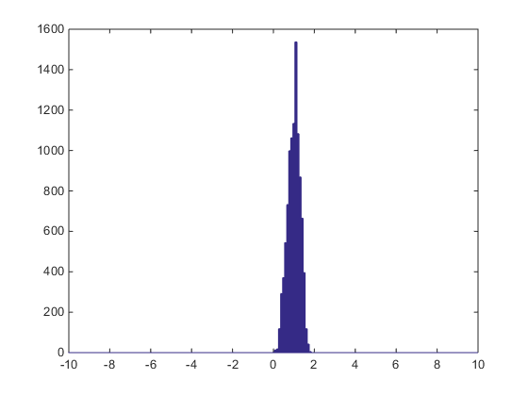
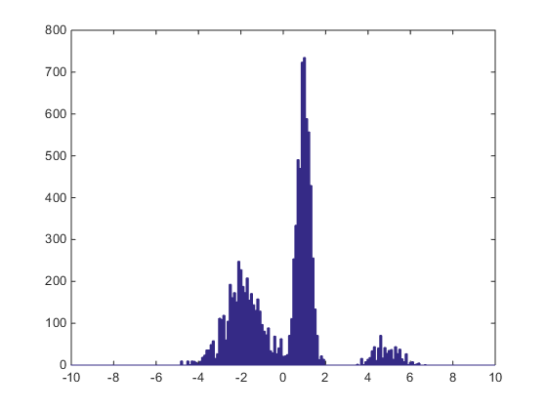
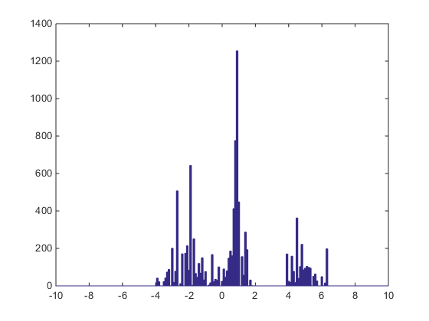
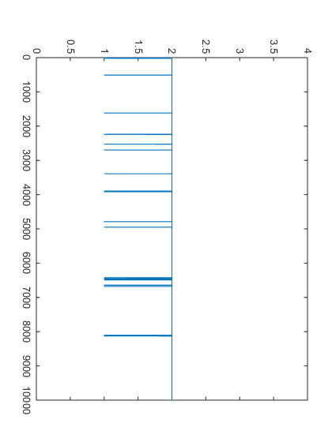
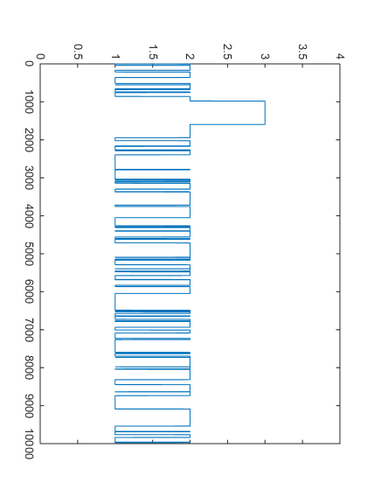
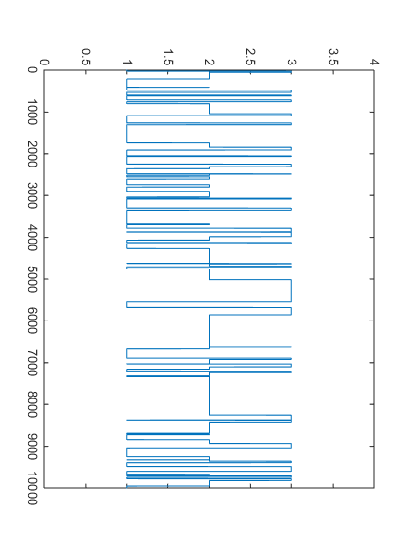
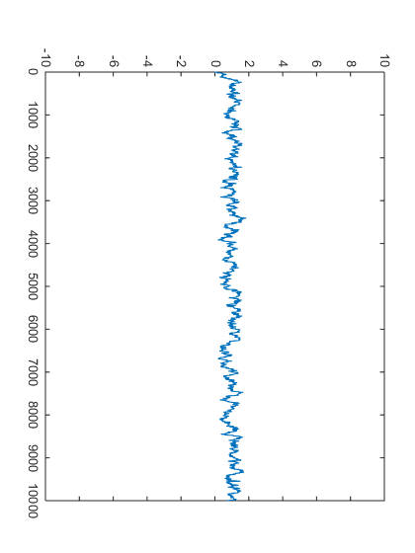
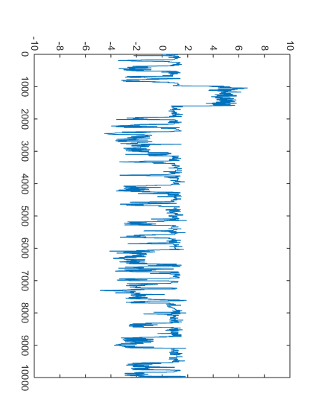
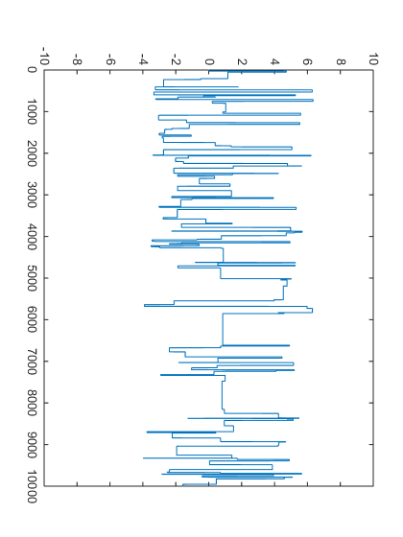
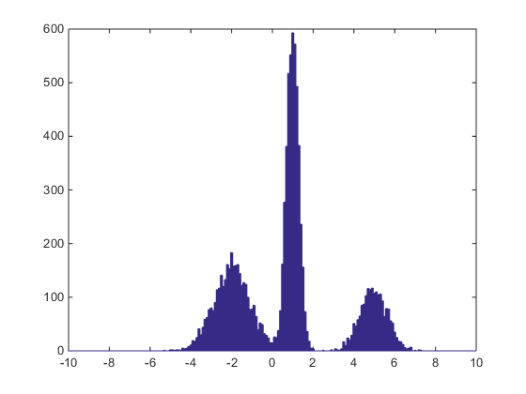

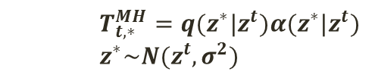


Result of
Random
Walk M-H
$σ^{2}$=0.1
$σ^{2}$=1
$σ^{2}$=40
Overall
Sampling
Sampling Result of
Random Walk M-H
Latent
Mode
Selection
Sampling
Observed
Variable
Sampling
Target Mixture
Distribution
    $$T_{t,∗}^{MH}=q(z^{∗}|z^{t})α(z^{∗}|z^{t})$$
    $$z^{∗}\sim N(z^{t},σ^{2})$$

Slide 14
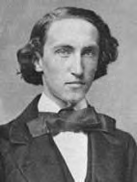
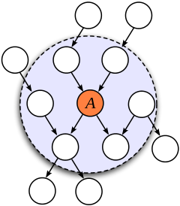
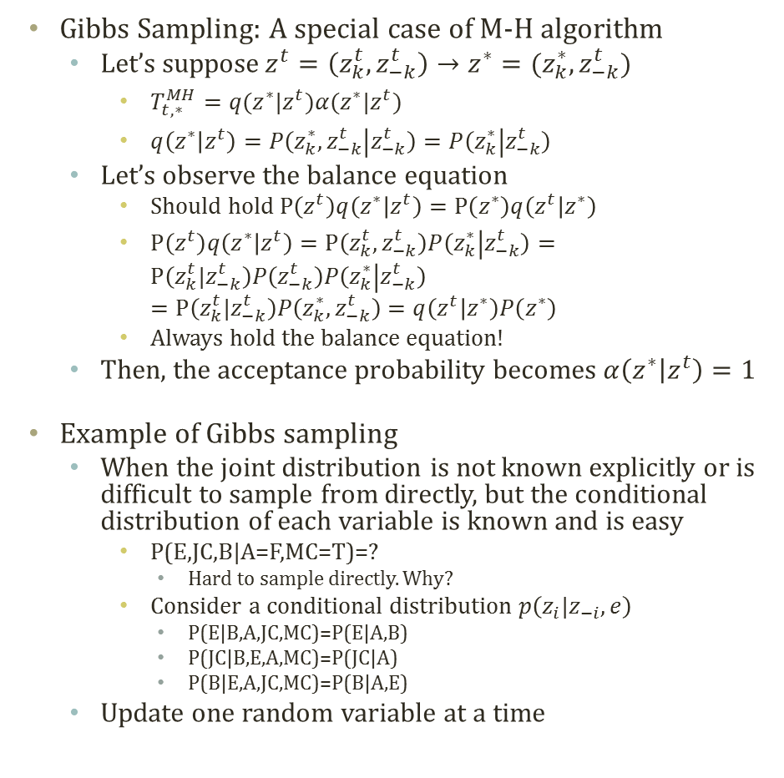
Gibbs Sampling
Josiah Willard Gibbs
(1839 - 1903)
- physicist
Gibbs Sampling: A special case of M-H algorithm
  Let’s suppose$z^{t}=\left(z_{k}^{t},z_{−k}^{t}\right)→z^{∗}=(z_{k}^{∗},z_{−k}^{t})$
    $T_{t,∗}^{MH}=q(z^{∗}|z^{t})α(z^{∗}|z^{t})$
    $q\left(z^{∗} | z^{t}\right)=P\left(z_{k}^{∗},z_{−k}^{t} | z_{−k}^{t}\right)=P\left(z_{k}^{∗} | z_{−k}^{t}\right)$
  Let’s observe the balance equation
    Should hold $P\left(z^{t}\right)q\left(z^{∗} | z^{t}\right)=P\left(z^{∗}\right)q\left(z^{t} | z^{∗}\right)$
    $P\left(z^{t}\right)q\left(z^{∗} | z^{t}\right)=P\left(z_{k}^{t},z_{−k}^{t}\right)P\left(z_{k}^{∗} | z_{−k}^{t}\right)=P\left(z_{k}^{t}|z_{−k}^{t}\right)P\left(z_{−k}^{t}\right)P\left(z_{k}^{∗} | z_{−k}^{t}\right)$
    $=P\left(z_{k}^{t}|z_{−k}^{t}\right)P\left(z_{k}^{∗},z_{−k}^{t}\right)=q\left(z^{t} | z^{∗}\right)P\left(z^{∗}\right)$
    Always hold the balance equation!
  Then, the acceptance probability becomes $α\left(z^{∗} | z^{t}\right)=1$
Example of Gibbs sampling
  When the joint distribution is not known explicitly or is difficult to sample from directly, but the conditional distribution of each variable is known and is easy
    P(E,JC,B|A=F,MC=T)=?
      Hard to sample directly. Why?
    Consider a conditional distribution $p\left(z_{i}|z_{−i}, e\right)$
      P(E|B,A,JC,MC)=P(E|A,B)
      P(JC|B,E,A,MC)=P(JC|A)
      P(B|E,A,JC,MC)=P(B|A,E)
  Update one random variable at a time
© Wikipedia
© Wikipedia
Buglary
Earthquake
Alarm
Can simplify using the Markov blanket
JohnCalls
MaryCalls
Notes:
Bayesian inference : prior posterior

Slide 15

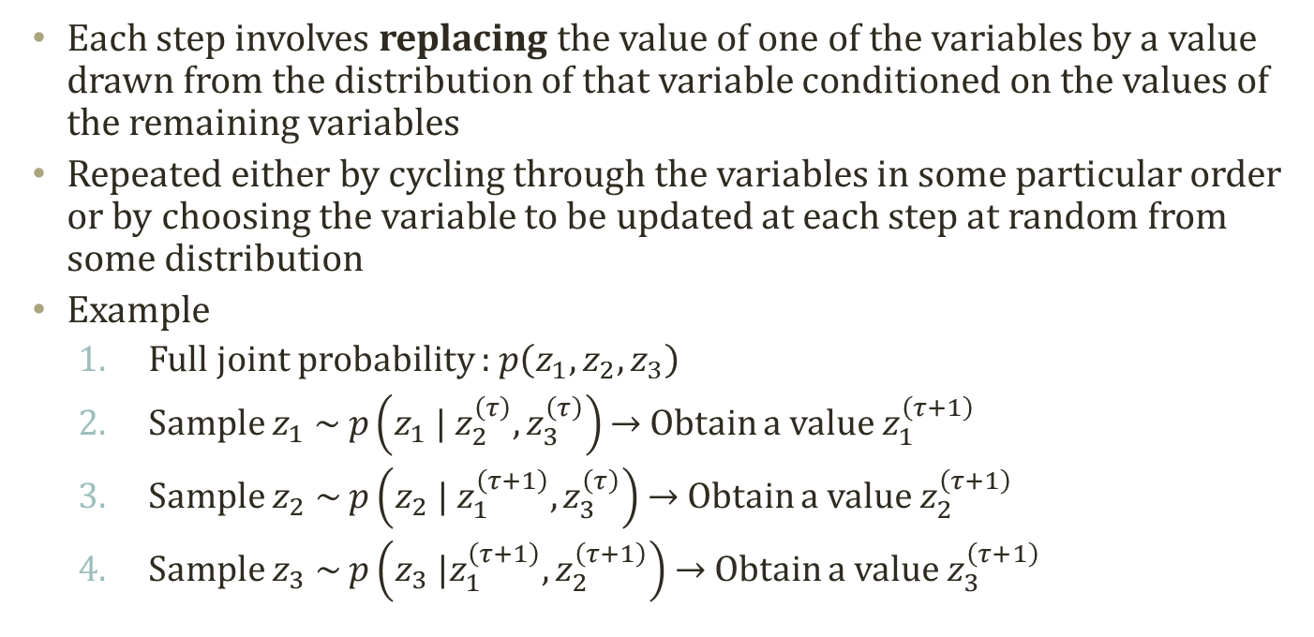



Concept of Gibbs Sampling
Each step involves replacing the value of one of the variables by a value drawn from the distribution of that variable conditioned on the values of the remaining variables
Repeated either by cycling through the variables in some particular order or by choosing the variable to be updated at each step at random from some distribution
Example
  Full joint probability : $p\left(z_{1},z_{2},z_{3}\right)$
  Sample $z_{1} \sim p\left(z_{1} | z_{2}^{\left(τ\right)},z_{3}^{\left(τ\right)}\right)$ → Obtain a value $z_{1}^{\left(τ+1\right)}$
  Sample $z_{2} \sim p\left(z_{2} | z_{1}^{\left(τ+1\right)},z_{3}^{\left(τ\right)}\right)$ → Obtain a value $z_{2}^{\left(τ+1\right)}$
  Sample $z_{3} \sim p\left(z_{3} |z_{1}^{\left(τ+1\right)},z_{2}^{\left(τ+1\right)}\right)$ → Obtain a value $z_{3}^{\left(τ+1\right)}$
$$\left\{z_{1}^{\left(τ\right)},z_{2}^{\left(τ\right)},z_{3}^{\left(τ\right)}\right\}$$
$$\left\{z_{1}^{\left(τ+1\right)},z_{2}^{\left(τ\right)},z_{3}^{\left(τ\right)}\right\}$$
$$\left\{z_{1}^{\left(τ+1\right)},z_{2}^{\left(τ+1\right)},z_{3}^{\left(τ\right)}\right\}$$
$$\left\{z_{1}^{\left(τ+1\right)},z_{2}^{\left(τ+1\right)},z_{3}^{\left(τ+1\right)}\right\}$$

Slide 16
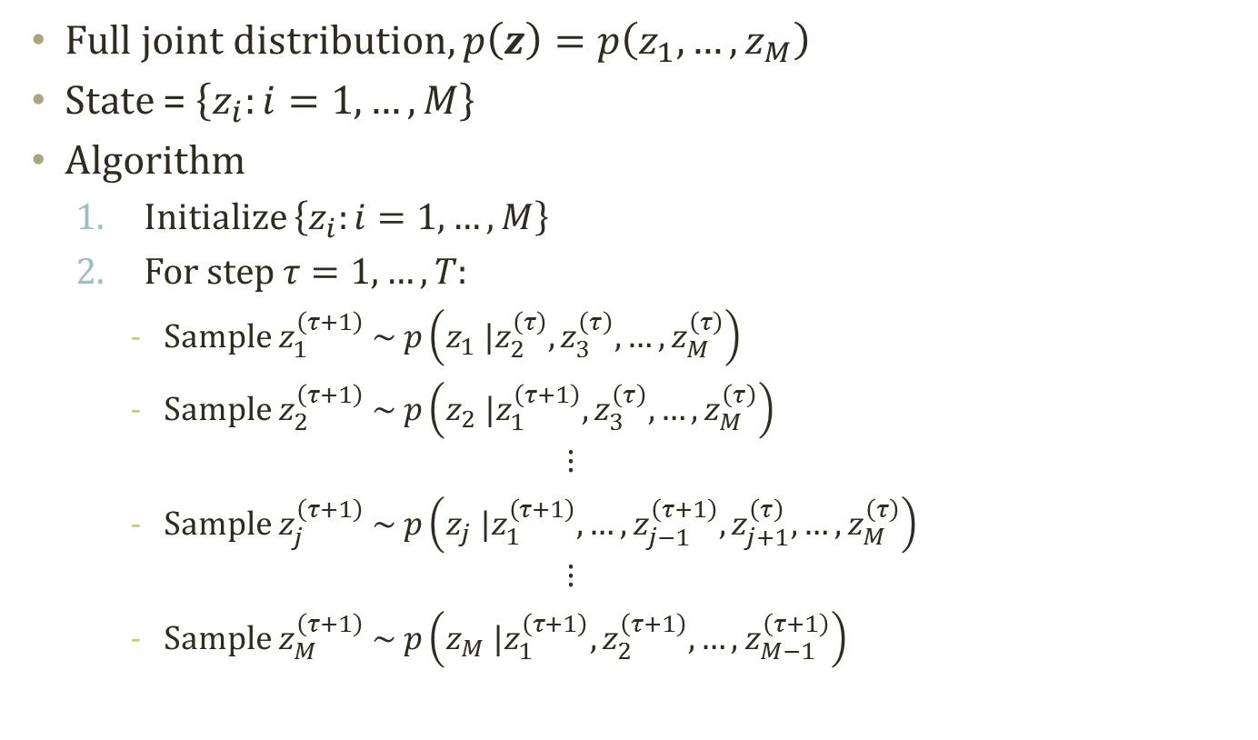
Gibbs Sampling Algorithm
Full joint distribution, $p\left(z\right)=p\left(z_{1},…,z_{M}\right)$
State = $\left\{z_{i}:i=1,…,M\right\}$
Algorithm
  Initialize $\left\{z_{i}:i=1,…,M\right\}$
  For step $τ=1,…,T:$
    Sample $z_{1}^{\left(τ+1\right)} \sim p\left(z_{1} |z_{2}^{\left(τ\right)},z_{3}^{\left(τ\right)},…,z_{M}^{\left(τ\right)}\right)$
    Sample $z_{2}^{\left(τ+1\right)} \sim p\left(z_{2} |z_{1}^{\left(τ+1\right)},z_{3}^{\left(τ\right)},…,z_{M}^{\left(τ\right)}\right)$
    $$⋮$$
    Sample $z_{j}^{\left(τ+1\right)} \sim p\left(z_{j} |z_{1}^{\left(τ+1\right)},…,z_{j−1}^{\left(τ+1\right)},z_{j+1}^{\left(τ\right)},…,z_{M}^{\left(τ\right)}\right)$
    $$⋮$$
    Sample $z_{M}^{\left(τ+1\right)} \sim p\left(z_{M} |z_{1}^{\left(τ+1\right)},z_{2}^{\left(τ+1\right)},…,z_{M−1}^{\left(τ+1\right)}\right)$

Slide 17
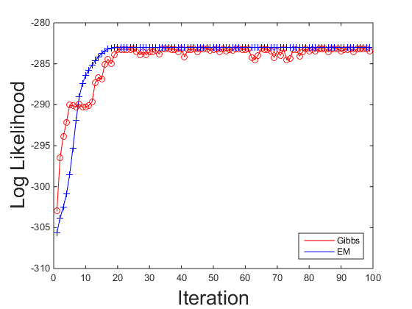
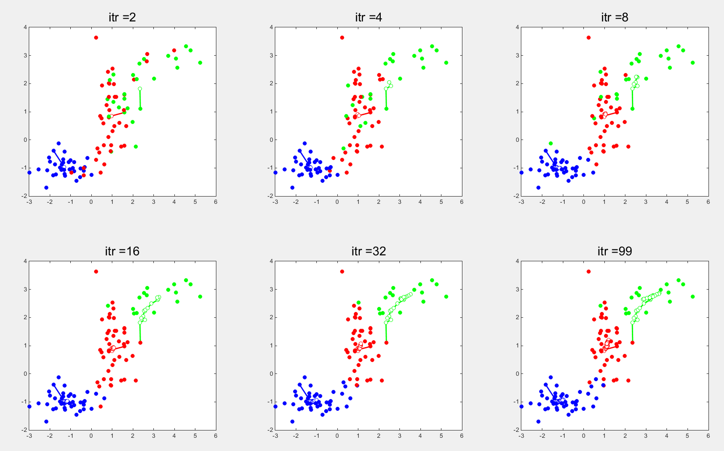
Gibbs Sampling based GMM
Hard to tell the performance with the simple GMM
  Sampling based inference
    Simulation based
  EM based inference
    Optimization based
Real power of Gibbs sampler comes from collapsing! → Collapsed Gibbs Sampler
  Let’s look at more sophisticated model for collapsing technique

